Slide 1
Voting System Testing & Certification
The EAC’s Role
Jerome Lovato
Director, Voting System Testing & Certification
U.S. Election Assistance Commission

Slide 2
You work in elections? So you only work once a year. Must be nice.
1

Slide 3
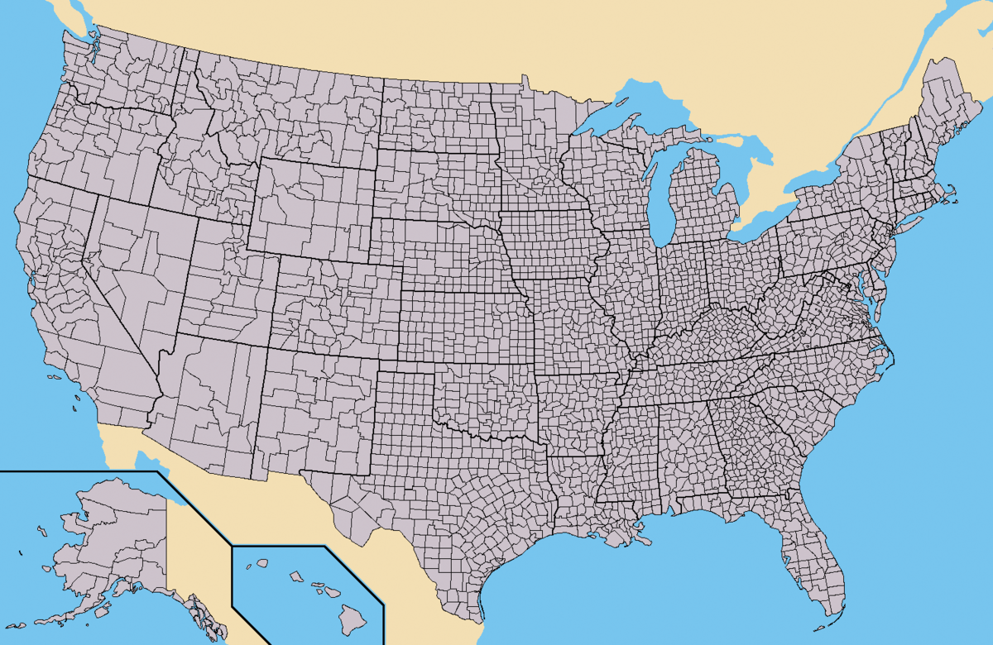
United States
2
Notes:
~10,000 jurisdictions

Slide 4
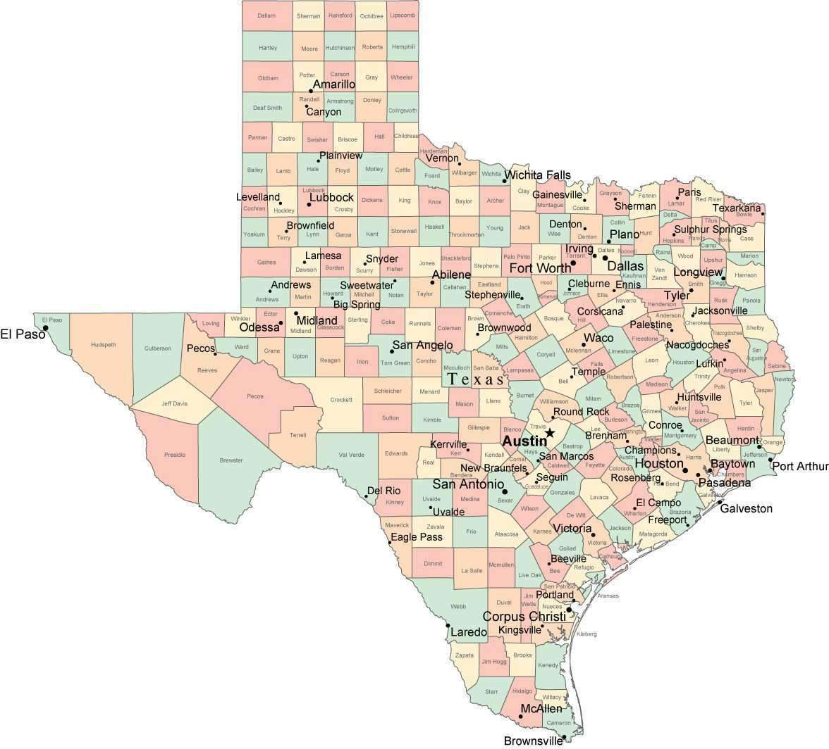
Texas
3
Notes:
254 counties…Georgia is next with 159
Wisconsin has 1,852 jurisdictions at the city, town, and village level

Slide 5
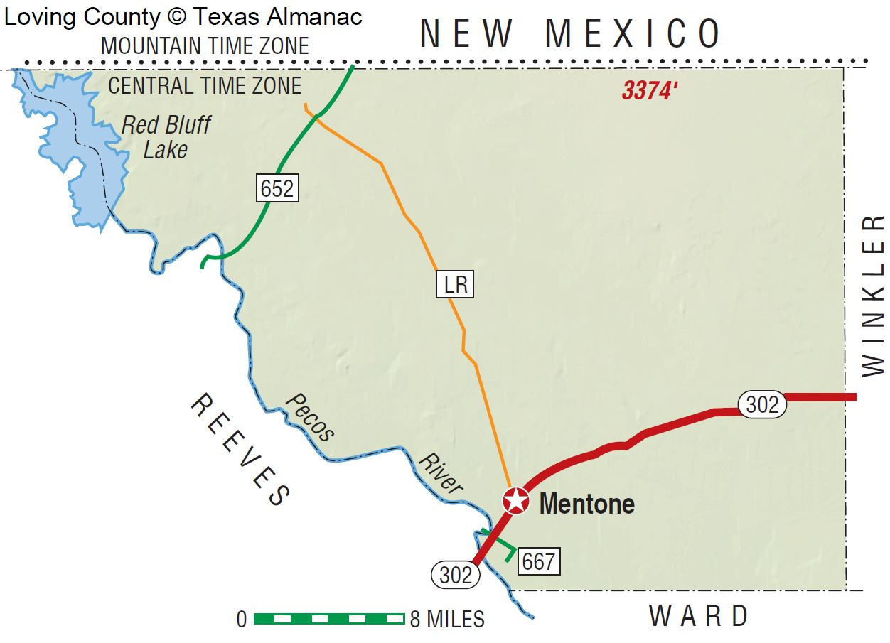
Loving County
4
Notes:
Population = 134

Slide 6
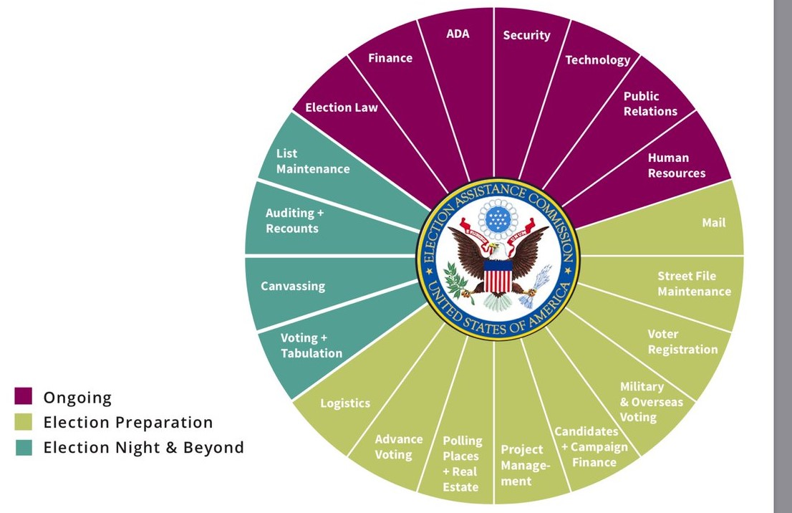
Election Administrator Competencies
5

Slide 7
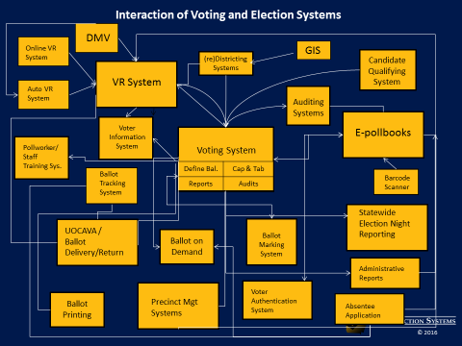
Interaction of Voting and Election Systems
PRESENTATION PLACE & DATE
6

Slide 8
EAC’s Role
Assistance is our middle name
Develop guidance to meet HAVA requirements
Responsible for adopting voluntary voting system guidelines
Serve as a national clearinghouse of information on election administration
Accredit testing laboratories
Certify voting systems
Audit the use of HAVA funds
Maintain the national mail voter registration form
7

Slide 9
EAC Testing & Certification Program
Voting systems
Approve (testing & certification is a 14-step process)
Reject
Decertify
Oversight
Voting system manufacturers (6)
Voting system test labs (2)
Election administrator support
Election Administrator as IT Manager training
Risk-limiting audit assistance
Agency support
Voluntary Voting System Guidelines 2.0
8

Slide 10
2019 Testing & Certification Highlights
Certified 10 voting systems
Voluntary Voting System Guidelines 2.0
Revised Principles & Guidelines document based on public comments
Initial draft of requirements are under review by TGDC
Provided “Election Administrators as IT Managers” training in Ohio, California, and Nevada
Provided risk-limiting audit pilot assistance to counties in Ohio and Pennsylvania
Presented on election security and voting system certification at various conferences and forums
9

Slide 11
2020 Testing & Certification Goals
Voluntary Voting System Guidelines 2.0
Finalize requirements for public comment
Publish revised program manuals (T&C Program Manual and VSTL Program Manual)
Conduct manufacturing site audits on all EAC-registered manufacturers before the 2020 General Election
Conduct voting system test lab audits on both EAC-accredited voting system test labs before the 2020 General Election
Implement additional vulnerability review and penetration testing into the Testing & Certification Program
Implement a voluntary election technology review program¹
10
Notes:
1. Provide a voluntary review of non-voting election technology such as electronic poll books, ballot delivery systems, election night reporting, ballot on demand systems, and other pertinent technology. Provide a clearinghouse for state-level testing of these technologies (i.e. Indiana and Virginia’s electronic poll book test reports).

Slide 12
How can we help?
11

Slide 13
Thank You!
12

Slide 14
Testing & Certification Contacts
Jerome Lovato
Director, Voting System Testing & Certification
jlovato@eac.gov
202-805-4613
Jessica Bowers
Senior Election Technology Specialist
jbowers@eac.gov
202-459-7861
Paul Aumayr
Senior Election Technology Specialist
paumayr@eac.gov
202-476-9051
13

